Slide 1
SURYA DIETARY PLAN APP

Slide 2
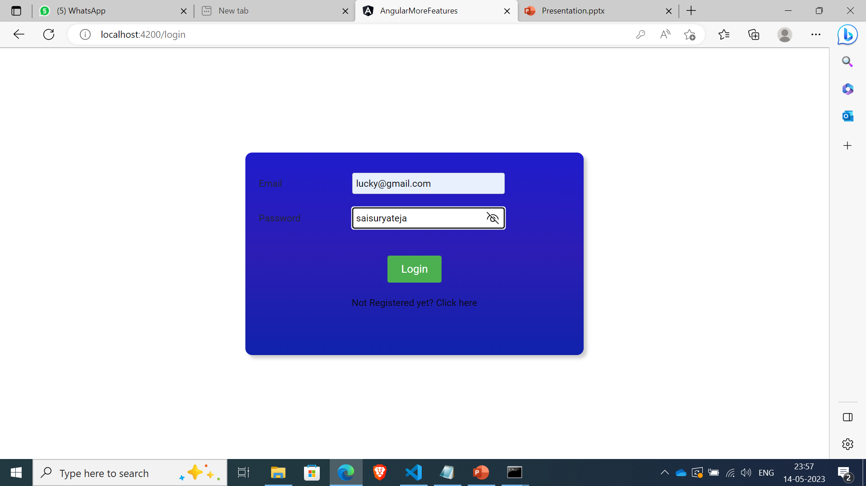
ADMIN:
Login page created using lazy loading feature

Slide 3
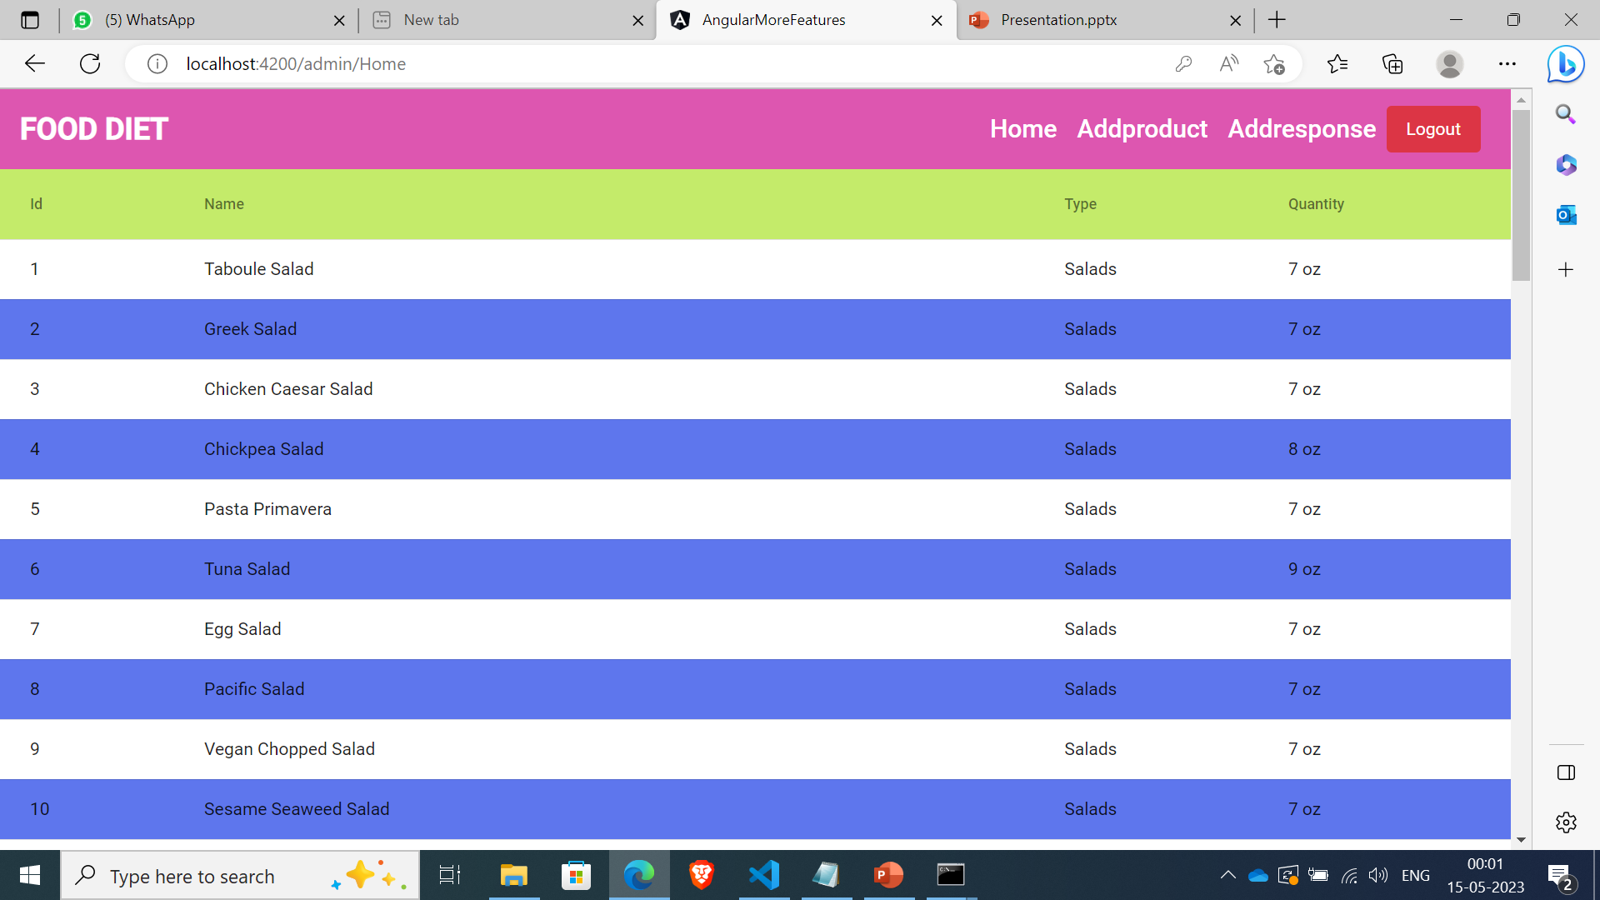
Menu bar contains home, add product and add response components
Home component contains product details like id,product name,type of product and quantity

Slide 4
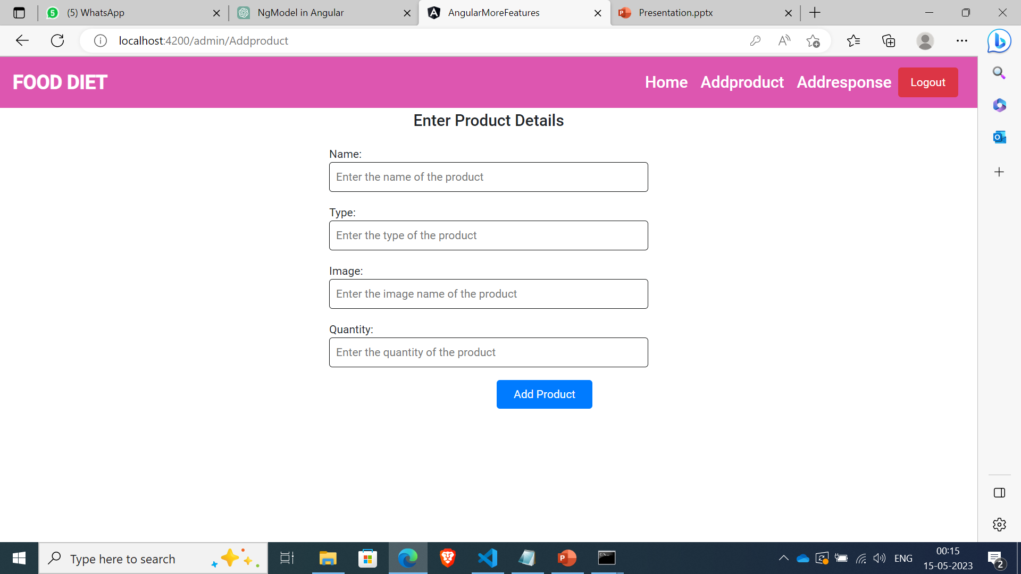
Add product component created to add products.
Ngmodel directive is used for data binding

Slide 5
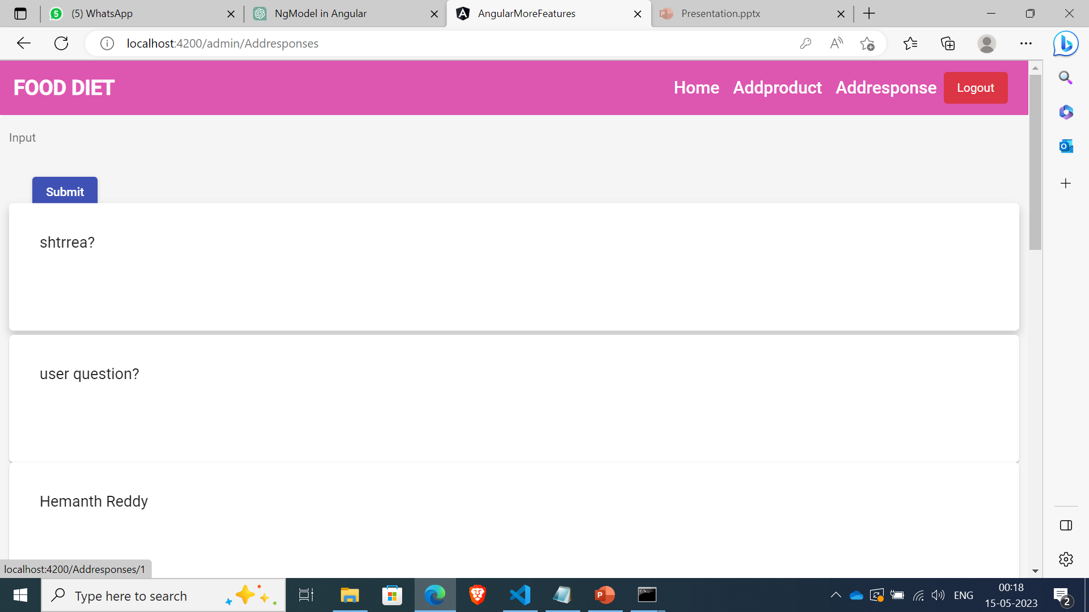
Addrespone component is created to give response to user for their questions.
Ngmodel directive is used

Slide 6
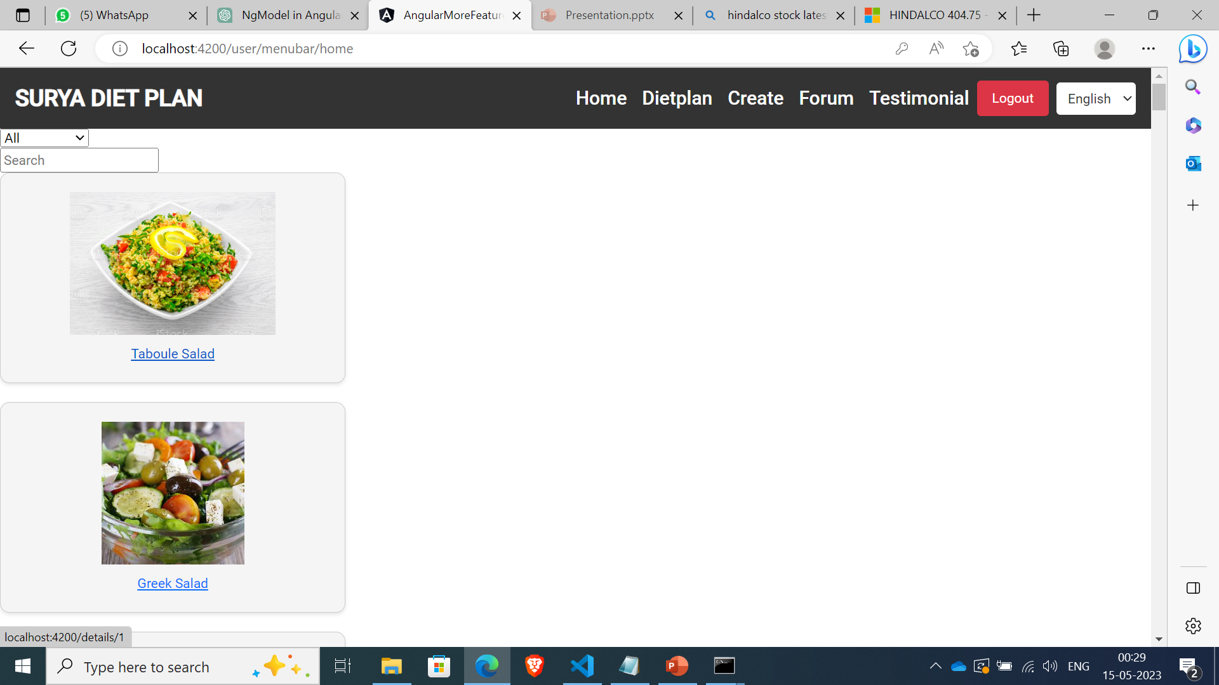
USER
Menu-bar component contains home,diet plan,create and forum components.
Home component contains different types of products like salad,fruits,vegetables

Slide 7
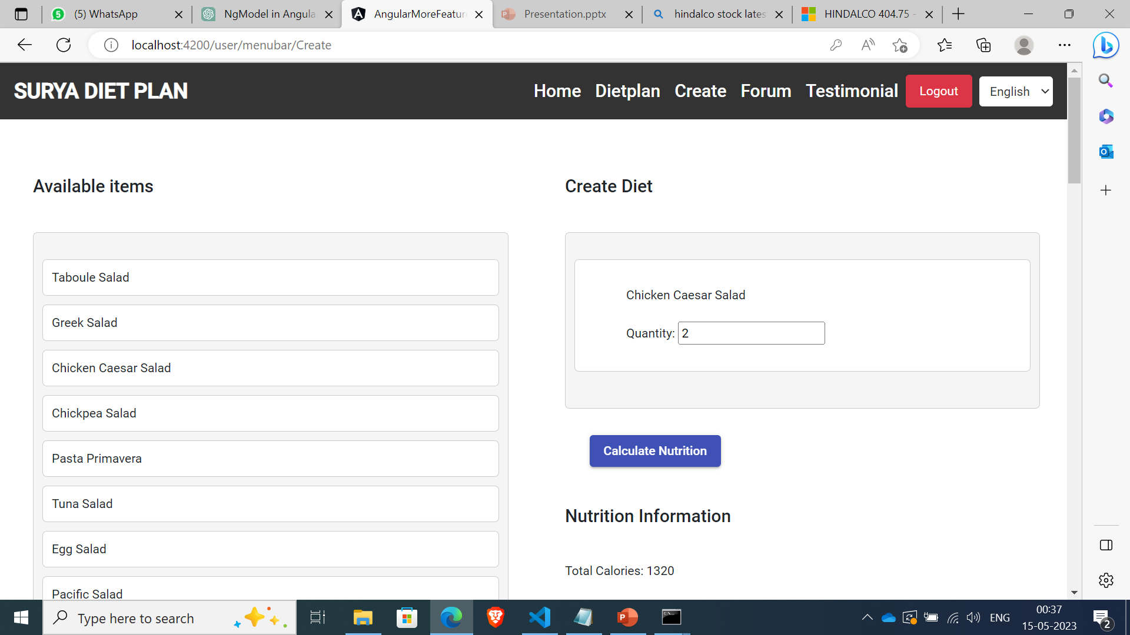
Create component contains drag and drop feature to calculate the nutrition value of the selected products.

Slide 8
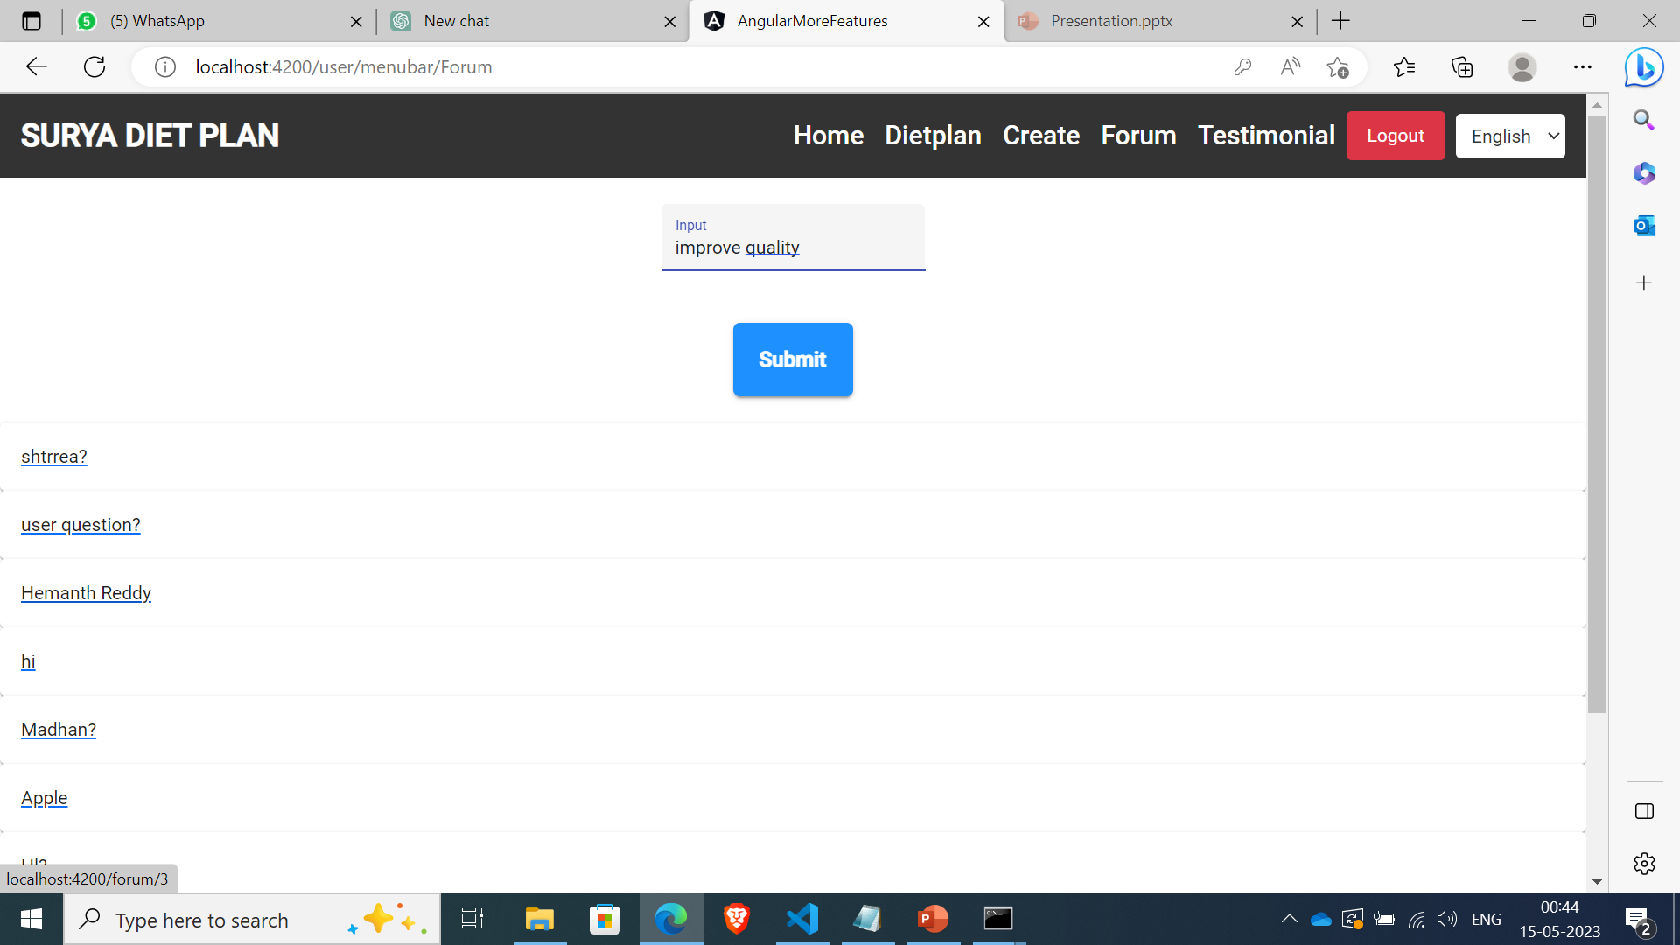
Forum page contains customer feedbacks

